Slide 1
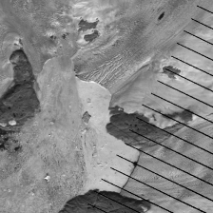
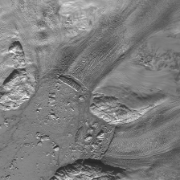
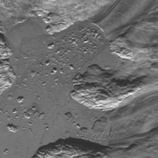
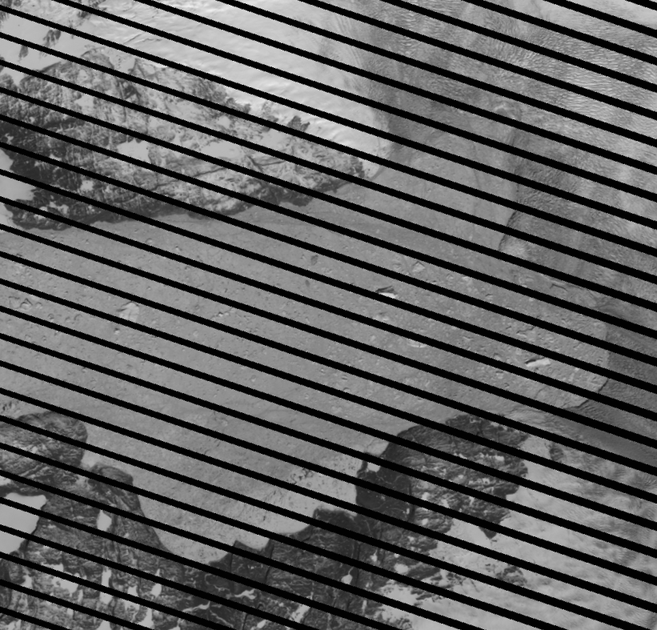
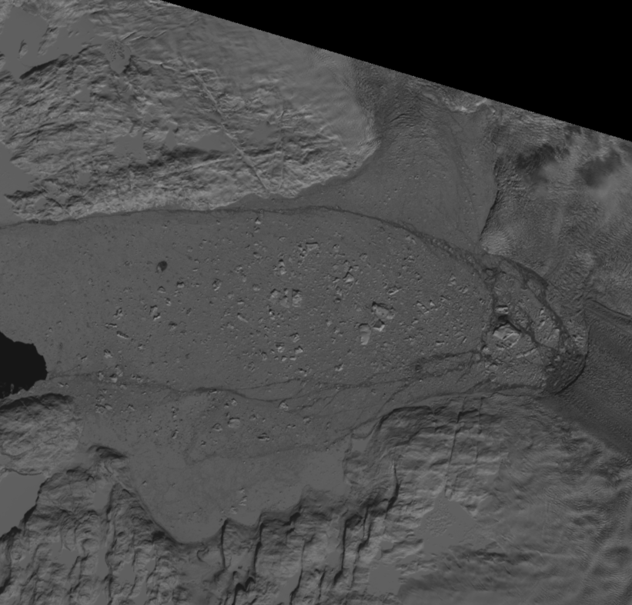
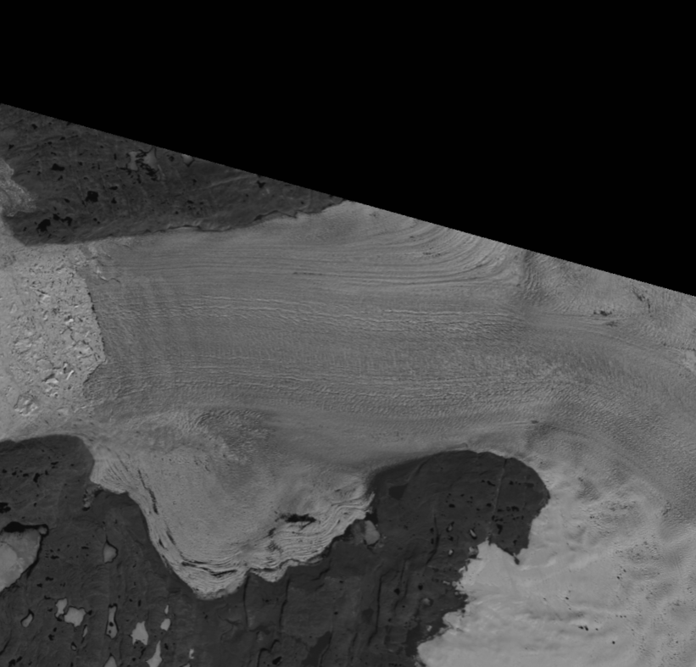
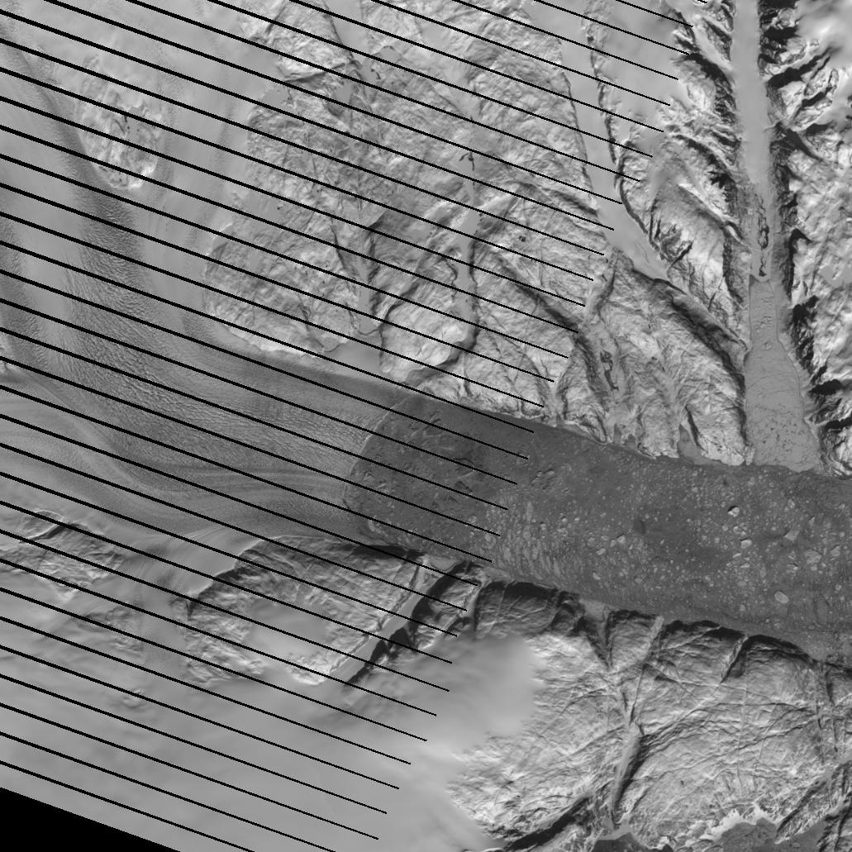
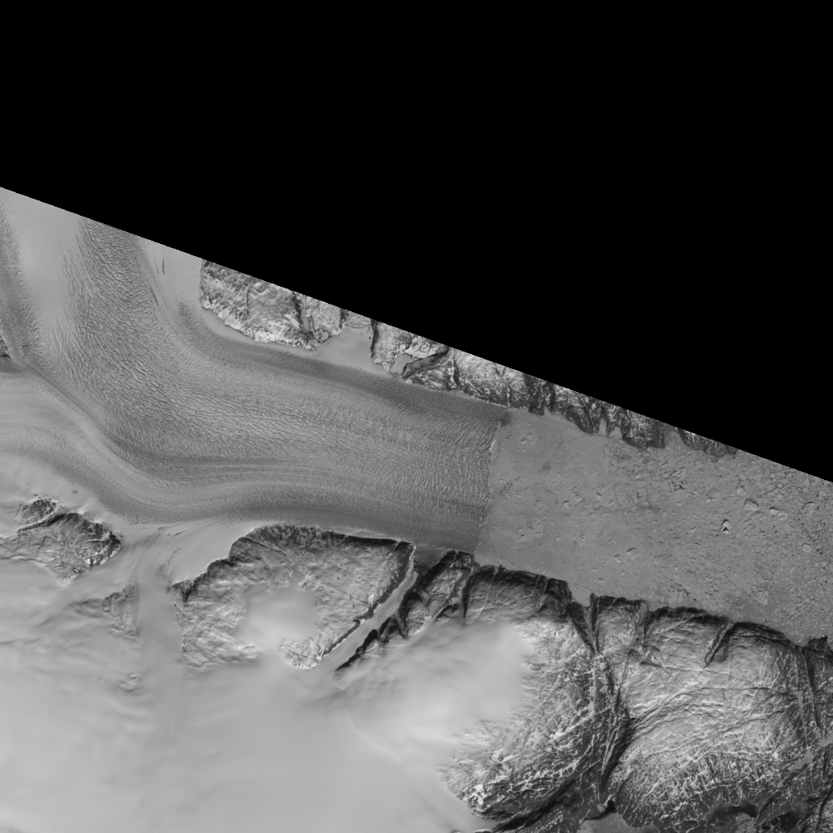
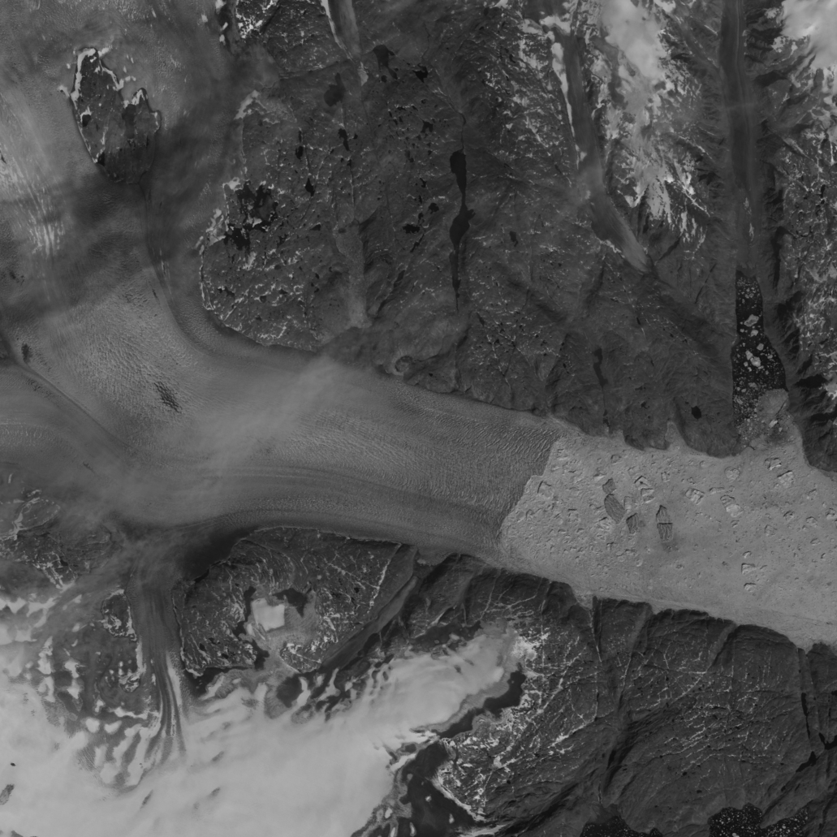
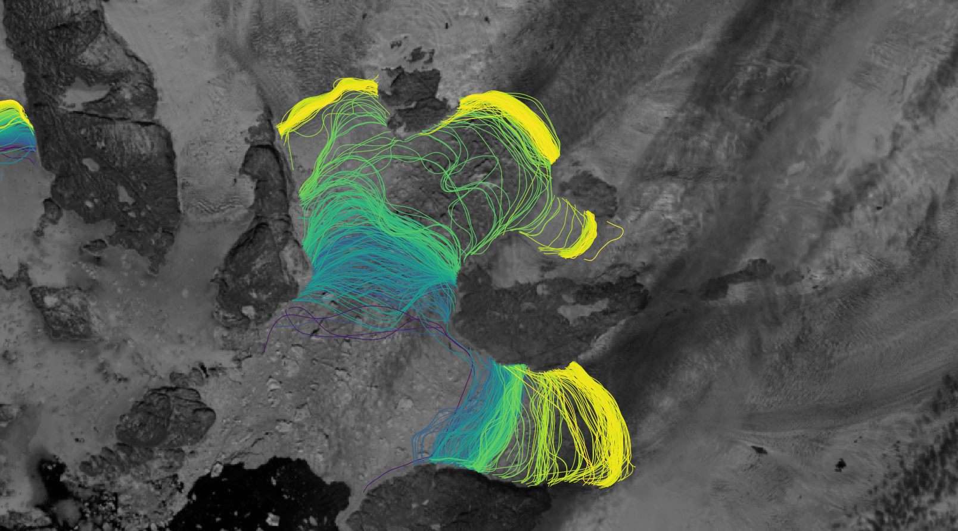
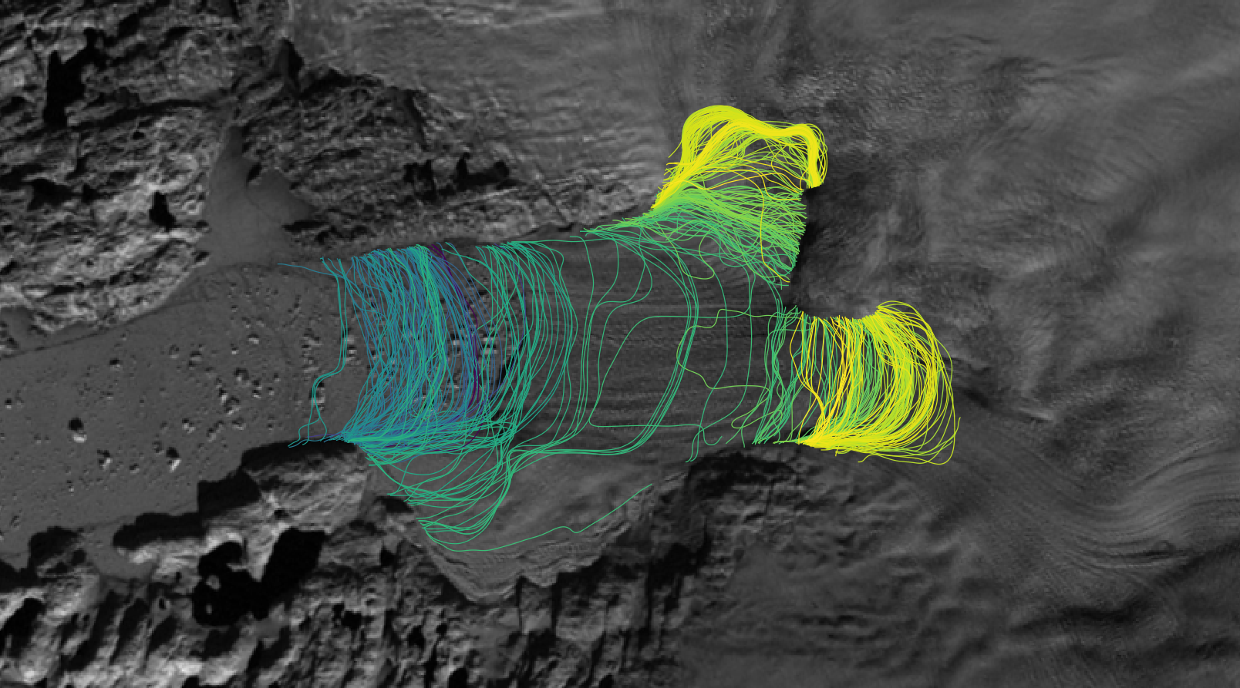
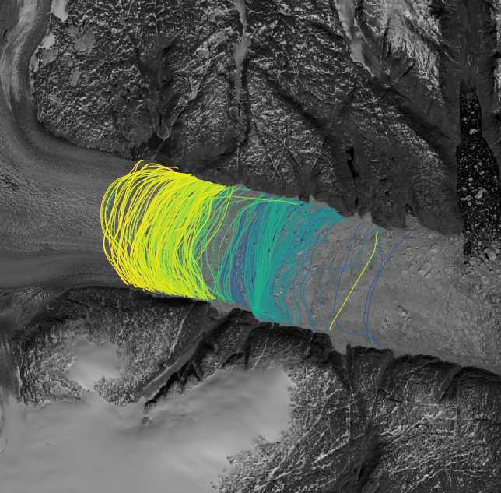


Automated Extraction of Glacial Features using Deep Learning
Daniel Cheng

Slide 2
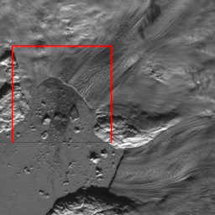
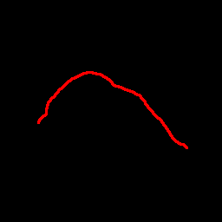
Outline
Motivation & Approach
Deep Learning & Methods
Results & Error Analysis
Existing & Future Work
?
Notes:
Technology & Dataset focused\
Initially presented at AGU 2018

Slide 3
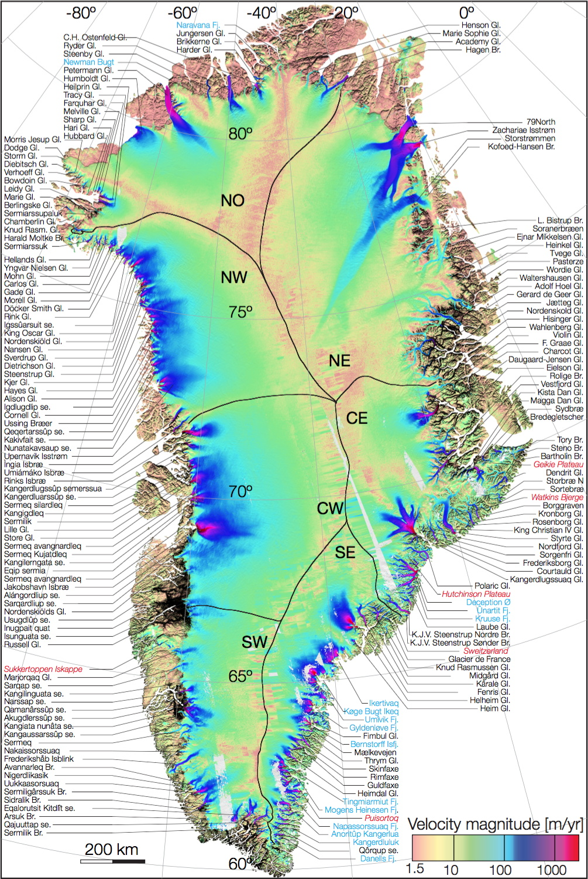
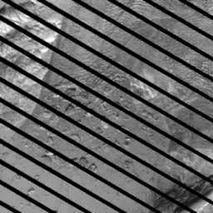
Motivation
Determining where glaciers end is useful
Manual labeling is time intensive, automatic labeling is non-trivial
We use Deep Neural Networks (AI/Machine learning)
Auto-label 20000+ subseasonal fronts over 66 basins
Hayes Glacier, 2006 April 06, Landsat 7 (USGS).
E. Rignot & J. Mouginot 2012
Notes:
Technology & Dataset focused\
Initially presented at AGU 2018

Slide 4
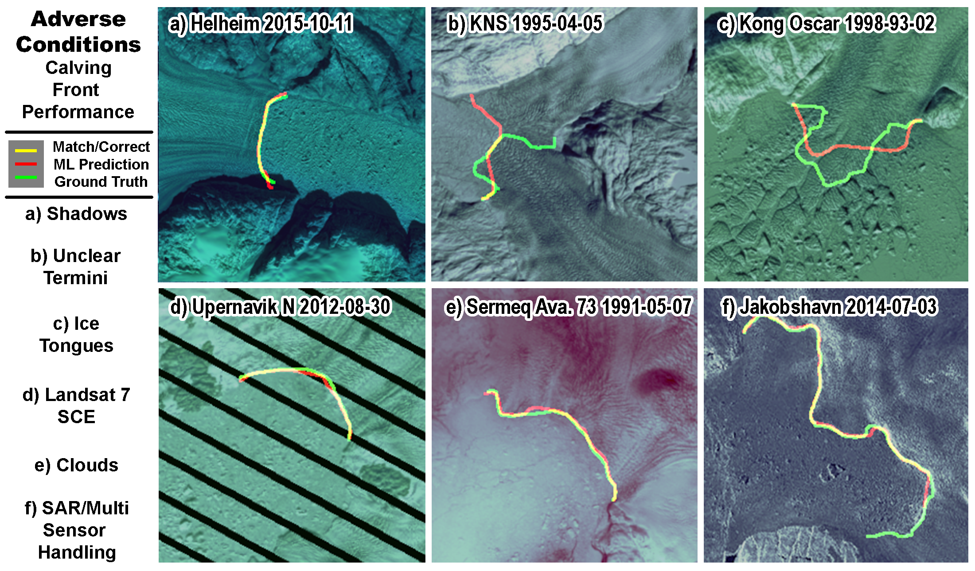
Notes:
Technology & Dataset focused\
Initially presented at AGU 2018

Slide 5
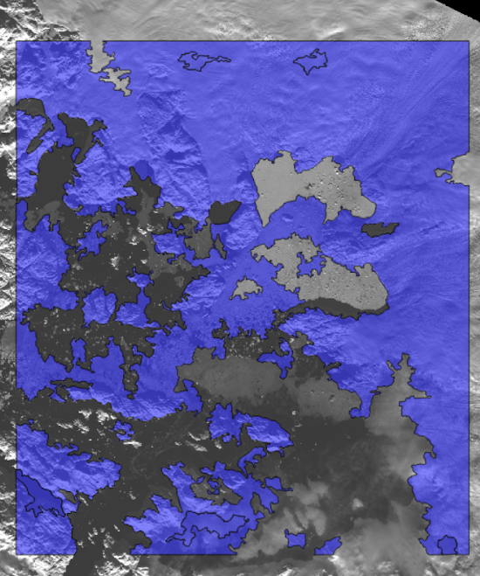
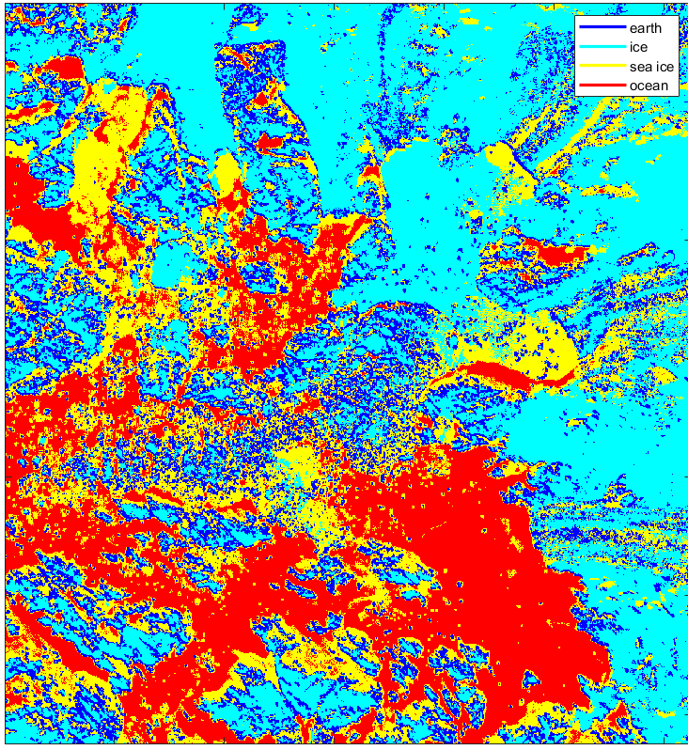
Approach
Edge detection not enough
Texture analysis not robust
Neural networks provide solution
X
X
Notes:
Edge detection is the naïve approach to this problem. Quickly apparent that it is easily fooled by brightness/contrast changes

Slide 6
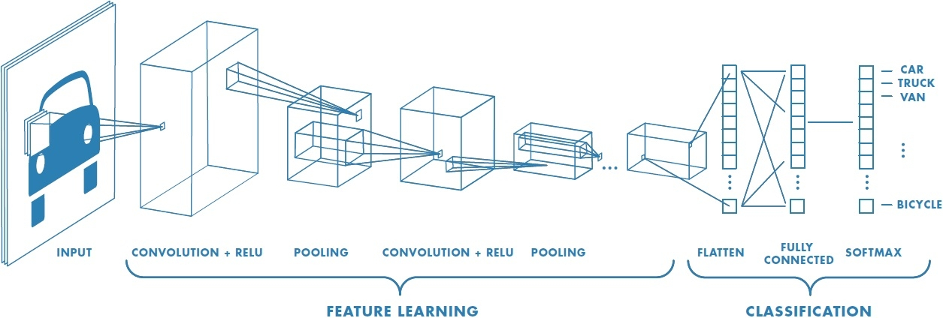

Approach – Neural Networks
NNs automatically learn features and relations between features
Convolutional NNs allow for shared filters, shared local context

Slide 7
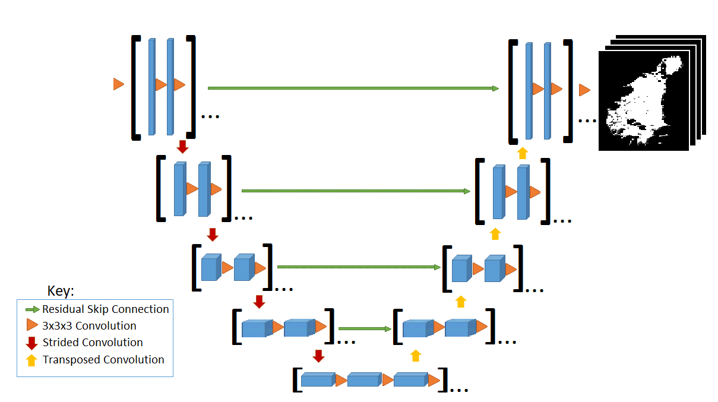
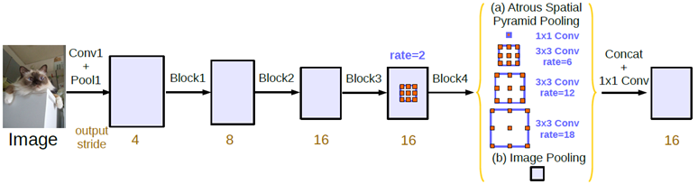
Deep Learning-
Neural Networks
UNet CNNs allow for shared near-global context, pixel-level segmentation, and efficient computation (O Ronneberger, 2015)
DeeplabV3+ with Xception backbone offers state of the art results (LC Chen, 2018)

Slide 8
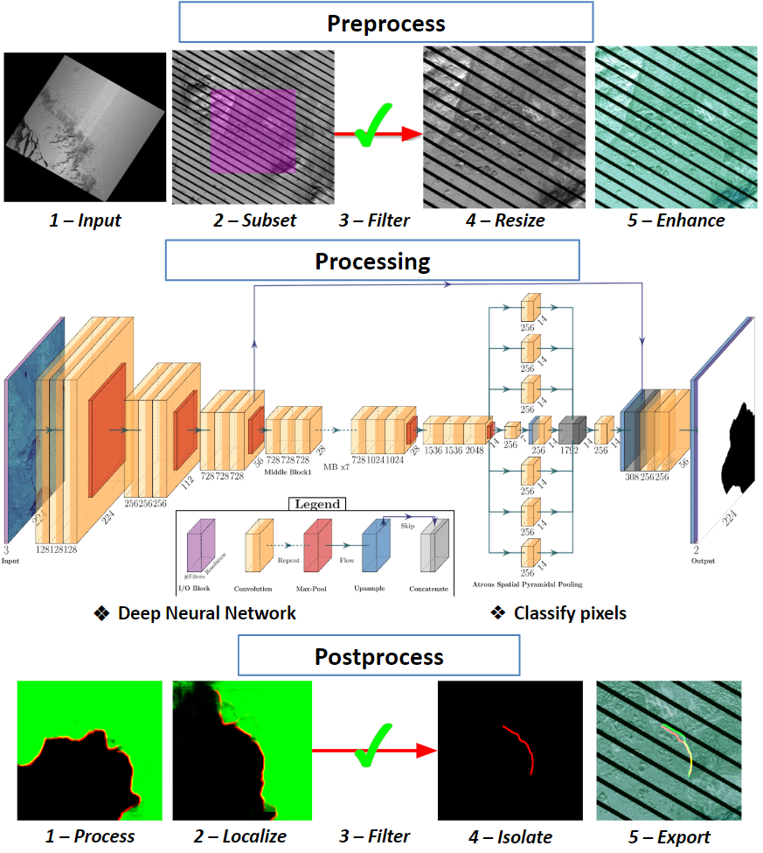
Method
Automated pipeline
Pre-process Landsat satellite imagery
Process and classify pixels with Neural Network
Post-process to extract vectorized calving front
Notes:
Technology & Dataset focused\
Initially presented at AGU 2018

Slide 9
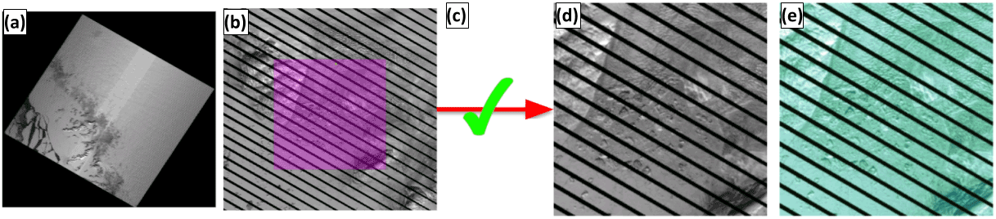
Method - Pre-processing
a) Get Raster Input
b) Subset the Input
c) Filter subsets
d) Resize subsets
e) Enhance details
Notes:
Technology & Dataset focused\
Initially presented at AGU 2018

Slide 10
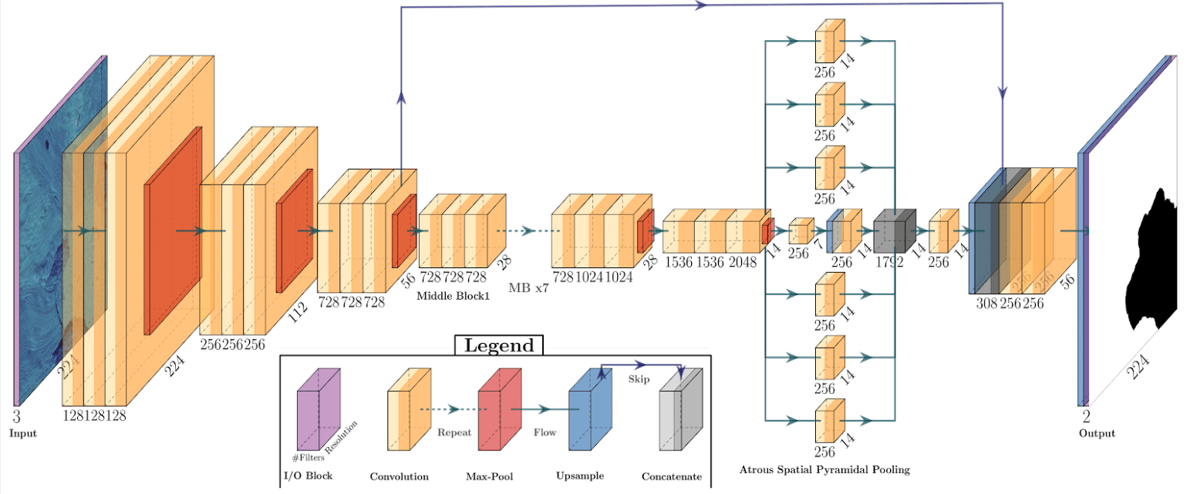
Method - Processing
CALFIN Neural Network (CALFIN-NN)
Classifies pixels
Notes:
Technology & Dataset focused\
Initially presented at AGU 2018

Slide 11
Method - Processing Insights
Network architecture was iterative
More “information” = better accuracy/faster training
Augment data, but be careful with non-affine transforms/distortions
Don’t label edges directly - edge filter after augmentation
Training data was made manually, and must be created consistently

Slide 12
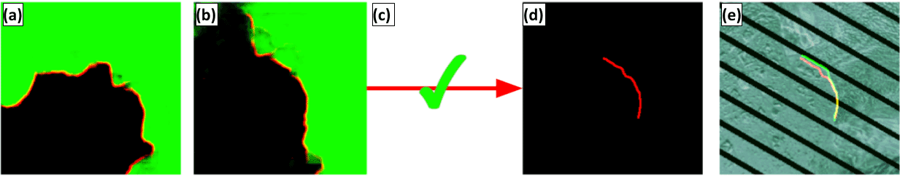
Method - Post-processing
a) Isolate calving fronts
b) Reprocess isolated subsets
c) Filter subsets
d) Reisolate calving fronts
d) Export and validate
Notes:
Technology & Dataset focused\
Initially presented at AGU 2018

Slide 13
Method - Post-processing Insights
Pixel-level mask not as useful as poly-line, polygon
Gaps in predicted output are processed during vectorization
Treat as Tourist Trip Design Problem (longest path through min. spanning tree with optional/weighted nodes)
Polygonization requires both calving front and ocean mask outputs

Slide 14
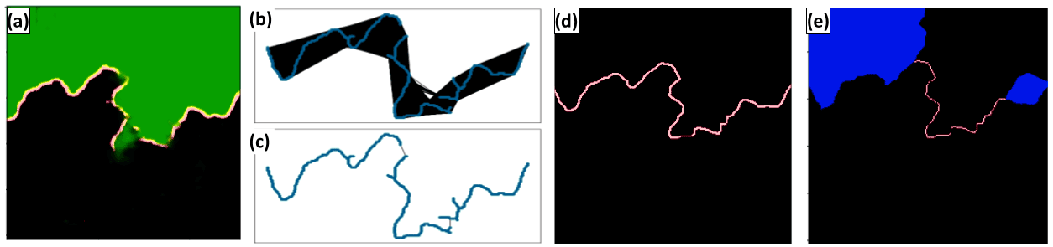
Method - Post-processing
a) Extract coastline mask
b/c) Find longest path in min. spanning tree
d) Rasterize coastline
e) Isolate calving front
Notes:
Technology & Dataset focused\
Initially presented at AGU 2018

Slide 15
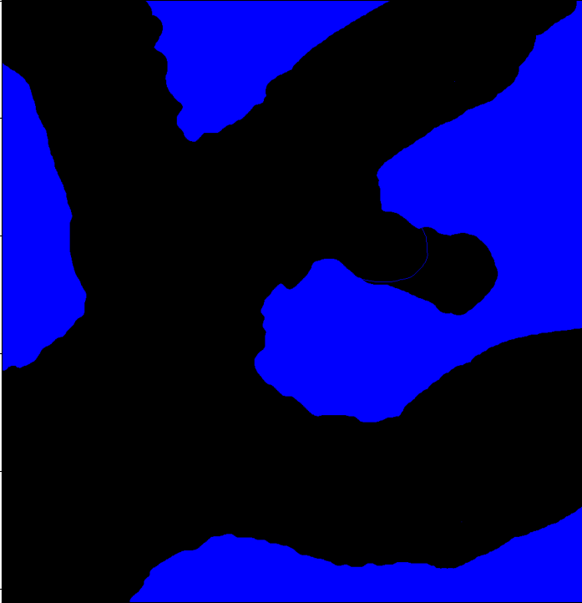
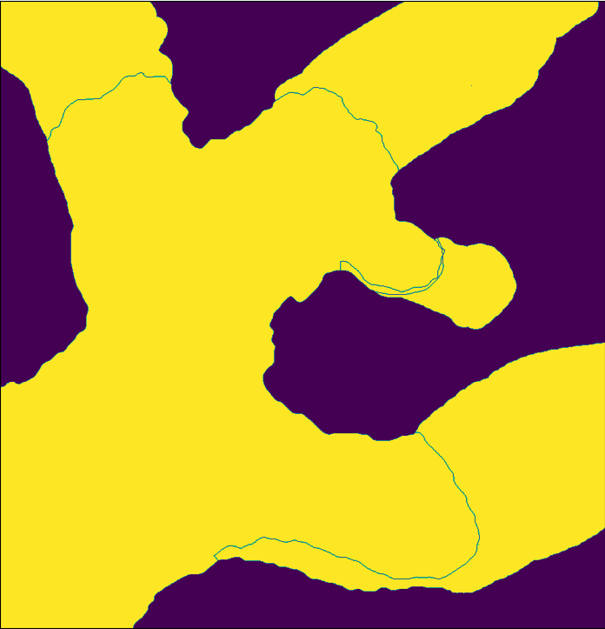

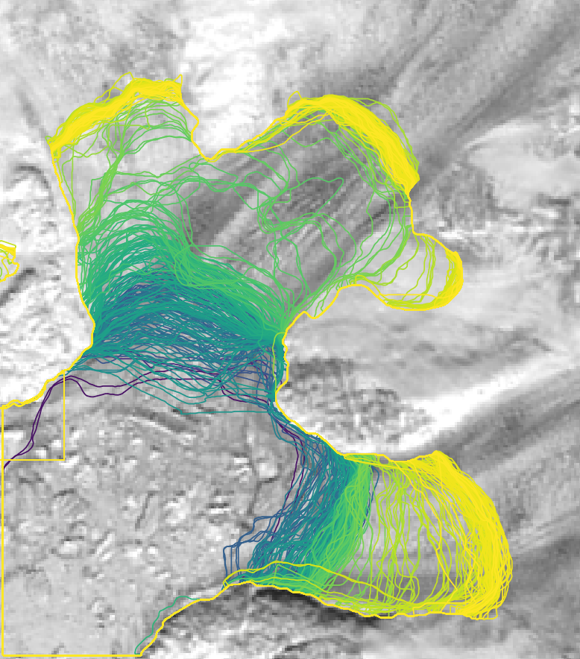
Method - Polygonization
a) Create fjord boundary mask
b) Rasterize fronts
c) Classify each section
d) Vectorize
Notes:
Technology & Dataset focused\
Initially presented at AGU 2018

Slide 16
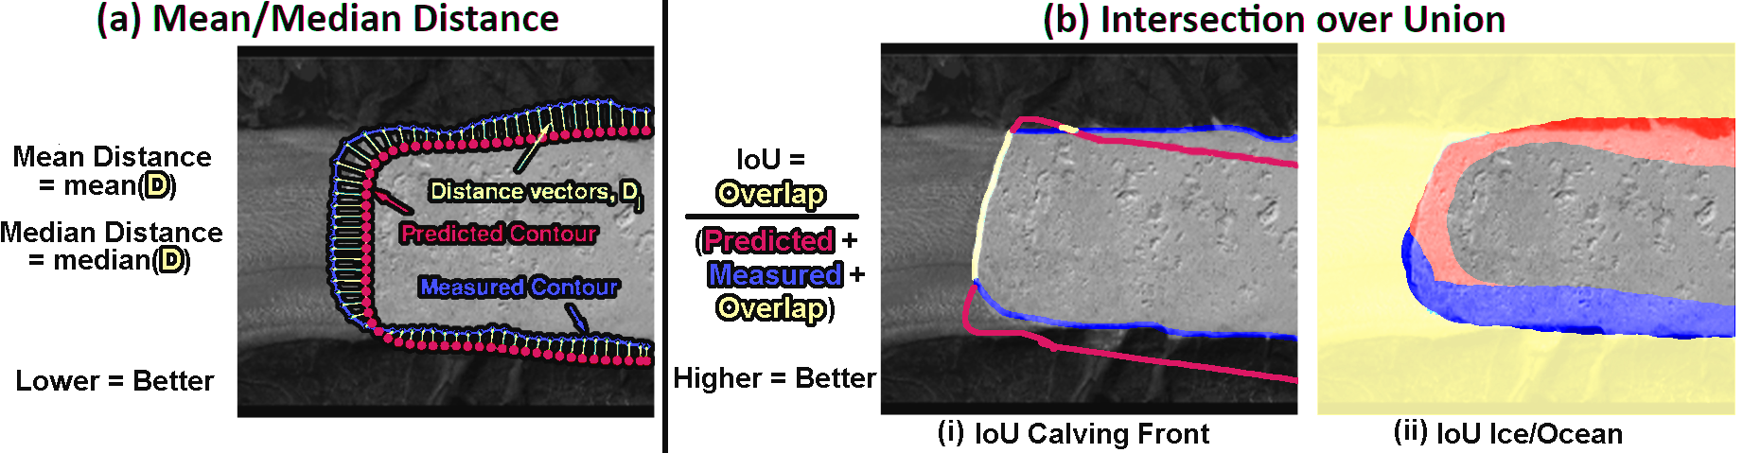
Error Analysis
Measuring Error
Mean/Median Distance
IoU Coastline = edge overlap
IoU Ice/Ocean = mask overlap
Intersection over Union
IoU Coastline = edge overlap
IoU Ice/Ocean = mask overlap
Evaluate validation sets
CALFIN (CALFIN-VS)
Zhang et al. 2019 (Z-VS)
Mohajerani et al. 2019 (M-VS)
Baumhoer et al. 2019 (B-VS)

Slide 17
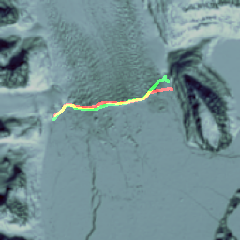
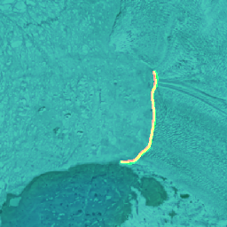
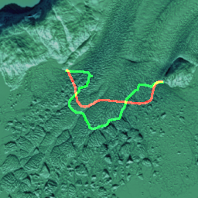
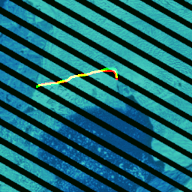
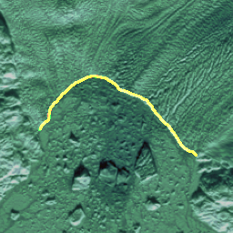
Error Analysis
Validation Set | Model | Mean Distance | Median Distance | IoU Coastline | IoU Ice/Ocean
CALFIN-VS | CALFIN-NN | 2.25px, 86.76m | 1.21px, 44.59m | 0.4884 | 0.9793
CALFIN Validation set
162 unseen images
Most adverse conditions handled well
Ice tongues need work
Rosenborg 1997-04-20
Jakobshavn-A 2017-06-02
Kong-Oscar 1998-03-26
Hayes-N 2008-08-10
Upernavik-N 2001-01-11

Slide 18
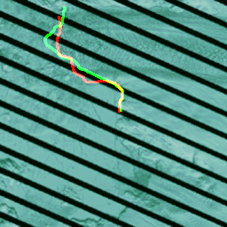
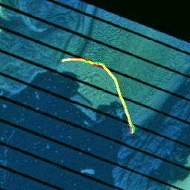
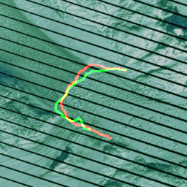
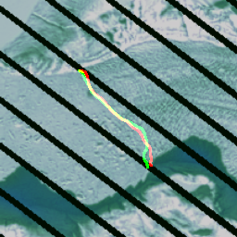
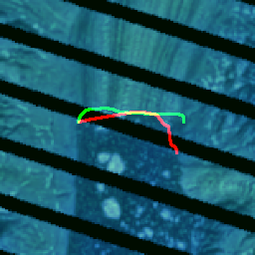
Error Analysis
Validation Set | Model | Mean Distance | Median Distance | IoU Coastline | IoU Ice/Ocean
CALFIN-VS L7SCE only | CALFIN-NN | 2.22 px, 91.93 m | 1.33 px, 49.24 m | 0.4888 | 0.9766
CALFIN-VS L7SCE none | CALFIN-NN | 2.27 px, 81.65 m | 1.16 px, 44.01 m | 0.4880 | 0.9819
CALFIN-VS L7SCE only
Only images that have Landsat 7 Scanline Corrector Errors
Higher error, as expected
CALFIN-VS L7SCE none
Lower error, as expected
Upernavik-SE 2009-04-27
Rink-Isbrae 2005-08-08
Kangerlussuaq 2012-04-19
Dietrichson 2008-04-23
Courtauld 2006-07-24

Slide 19
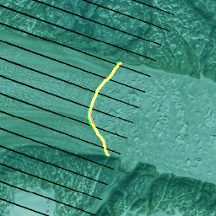
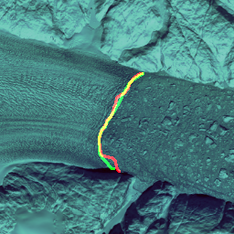
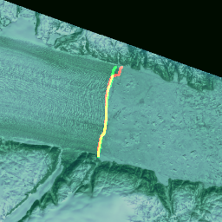
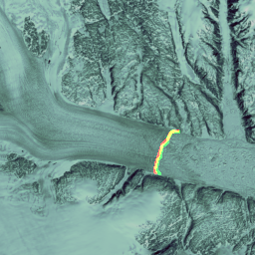
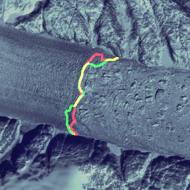
Error Analysis
Validation Set | Model | Mean Distance | Median Distance | IoU Coastline | IoU Ice/Ocean
CALFIN-VS Helheim | CALFIN-NN | 2.24px, 121.47m | 1.71px, 86.60m | 0.5039 | 0.9623
CALFIN-VS Helheim
Handles Multiscale/L7 SCE
Error near fjord walls
Provides strong evidence of generalization
Helheim 2003-08-08
Helheim 2013-04-12
Helheim 2000-05-27
Helheim 1993-06-08
Helheim 1995-04-20

Slide 20
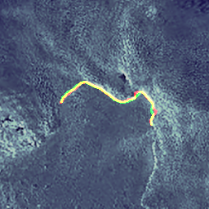
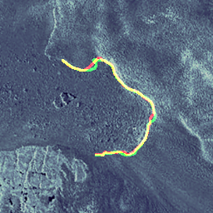
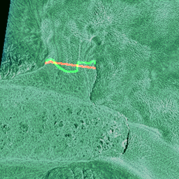
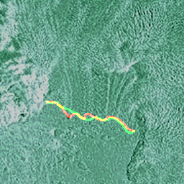

Error Analysis
Validation Set | Model | Mean Distance | Median Distance | IoU Coastline | IoU Ice/Ocean
Z-VS | CALFIN-NN | 2.11 px, 115.24 m | 1.65 px, 77.29 m | 0.3832 | 0.9761
Z-VS | Z-NN | 17.3 px, 104 m | N/A | N/A | N/A
Zhang et al. 2019
6 TerraSAR-X Jakobshavn images
On par with original study
Jakobshavn-B TSX-1 2014-07-03
Jakobshavn-A TSX-1 2014-07-03
Jakobshavn-B TSX-1 2010-05-06
Jakobshavn-B TSX-1 2011-06-17
Jakobshavn-A TSX-1 2011-06-17

Slide 21





Error Analysis
Validation Set | Model | Mean Distance | Median Distance | IoU Coastline | IoU Ice/Ocean
B-VS | CALFIN-NN | 2.35 px, 330.63 m | 0.74 px, 112.75 m | 0.6451 | 0.9879
B-VS | B-NN | 2.69 px, 108 m | N/A | N/A | 0.905
Baumhoer et al. 2019
62 Sentinel-1 SAR Antarctica images
Subpar but reasonable performance w.r.t. original study
Aviator S1B 2018-06-29
Gillet S1B 2018-06-26
Shackleton S1A 2018-06-23
Icebreaker-Fitzgerald S1B 2018-06-29
Land S1A 2018-06-23

Slide 22



Error Analysis
Validation Set | Training Set | Model | Mean Distance | Median Distance | IoU Coastline | IoU Ice/Ocean
M-VS | CALFIN-TS | CALFIN-NN | 2.56 px, 97.72 m | 2.55 px, 97.44 m | 0.3332 | N/A
M-VS | M-TS | M-NN | 1.97 px, 96.31 m | N/A | N/A | N/A
CALFIN-VS L7SCE none | CALFIN-TS | CALFIN-NN | 2.27 px, 81.65 m | 1.16 px, 44.01 m | 0.4880 | 0.9819
CALFIN-VS L7SCE none | CALFIN-TS | M-NN | 4.45 px, 201.35 m | 1.25 px, 50.52 m | 0.4935 | 0.9699
Mohajerani et al. 2019
10 Landsat Helheim images
On par with original study
Model Intercomparison
Retrain M-NN, isolate only the NN model
We outperform M-NN
Helheim 1989-06-29
Helheim 2015-07-07
Helheim 2000-03-31

Slide 23

Error Analysis
TermPicks Comparison
Compare manual and automated methods
Cheng (CALFIN) on par with most others (107m)
Discrepancy with Hill explained by focus on North Greenlandic glaciers (Kong-Oscar)

Slide 24





Results
Data Release
Shapefile Polylines
22678 total fronts,
20681 auto-picked
1997 manual
Shapefile Polygons
22678 total fronts
Includes Training data, Neural Network weights
Released on National Snow and Ice Data Center
Upernavik
Jakobshavn
Helheim
Training & validation data for 66 basins, plus 51 Antarctic basins from Zhang, Mohajerani, and Baumhoer

Slide 25


Results - Spatial/Temporal Coverage
Nagler, 2015

Slide 26

Results - Comparison With Existing Work

Slide 27

Results - Comparison With Existing Work

Slide 28

Results - Comparison With Existing Work

Slide 29

Results - Comparison With Existing Work
1995

Slide 30

Results - Regional Trends

Slide 31
Conclusion &
Future Work
Conclusion
Human level accuracy of ~100m for all Greenland is possible & achieved
Multi-sensor handling (Sentinel/SAR) is possible & is achieved
Neural Networks viable for glacial feature extraction
Future work
Modeling with Ice-sheet and Sea-level System Model (ISSM)
Extended Feature Detection (iceberg, sediment plume, etc.)
Increased spatio-temporal coverage (using Sentinel, Antarctica, etc.)

Slide 32
Thanks!
References & Related Work
Daniel Cheng, Wayne Hayes, Eric Larour, Yara Mohajerani, Michael Wood, Isabella Velicogna, and Eric Rignot. Calving Front Machine (CALFIN): Glacial termini dataset and automated deep learning extraction method for Greenland, 1972–2019. The Cryosphere, 15(3), 1663–1675.
Yara Mohajerani, Michael Wood, Isabella Velicogna, and Eric Rignot. Detection of glacier calving margins with convolutional neural networks: A case study. Remote Sensing, 11(1), 2019
Enze Zhang, et al. Automatically delineating the calving front of Jakobshavn Isbrae from multi-temporal TerraSAR-X images: a deep learning approach. The Cryosphere Discussions, 2019:1–20, 2019.
Celia A. Baumhoer, Andreas J. Dietz, and Claudia Kuenzer. Automated Extraction of Antarctic Glacier and Ice Shelf Fronts from Sentinel-51 Imagery Using Deep Learning, Remote Sensing, 11, 2529.
Sophie Goliber, et al, TermPicks: A century of Greenland glacier terminus data for use in machine learning applications, The Cryosphere Discuss., in review, 2021.
jpl.nasa.gov
Daniel Cheng - dlcheng@uci.edu
Wayne Hayes - whayes@uci.edu
Eric Larour - Eric.Larour@jpl.nasa.gov
ISSM Team

